Slide 1
Application of Team-Based Learning to a First-Semester IPLS Course B. Toggerson – AAPT SM17 http://physedgroup.umasscreate.net/
Flex Grant Program
QR Code linking to talk
Brokk Toggerson
Lecturer
Heath Hatch
Lecturer
Paul Bourgeois
Lecturer
Christopher Ertl
Lecture Prep
David Nguyen
M.Ed. Student

Slide 2
Physics 131 – Our First Semester IPLS Course
Our Students
Our Room
Goal: To develop a system of course components for these students in this space
Notes:
This is a work in progress (since spring 2014)
Translate BCT
Treating as 100% life science up to this point
Note large fraction of Kinesiology majors
UMass has very strong Kinesiology program
Results in a different focus than IPLS courses dominated by cell-level biology students

Slide 3
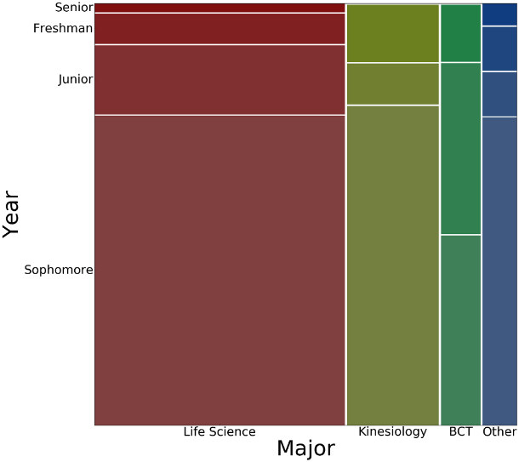
Our Students → Our Content^{[1][2][3]}
Our course has a modular unit-based structure
Depth > Breadth
Mathematical Tools and Foundational Concepts
Key definitions (velocity, acceleration)
Mathematical tools (simulation, vectors, graphs)
Forces
Unified force concept
Problem solving skills
Forces and…
Impulse (force and a time), torque (force and a position), work (force and a distance)
Impulse and torque are key concepts for our kinesiology majors
Energy
Explicitly trying to connect ideas of energy from biology and chemistry with ideas in physics^{[4]}
Unified idea of energy across distance scales
Entropy
Statistical interpretation of entropy^{[5]}
Notes:
Want to make sure that our content is appropriate for our students
Built a lot on the work done by the rest of the IPLS community especially the work done by UMD et al

Slide 4
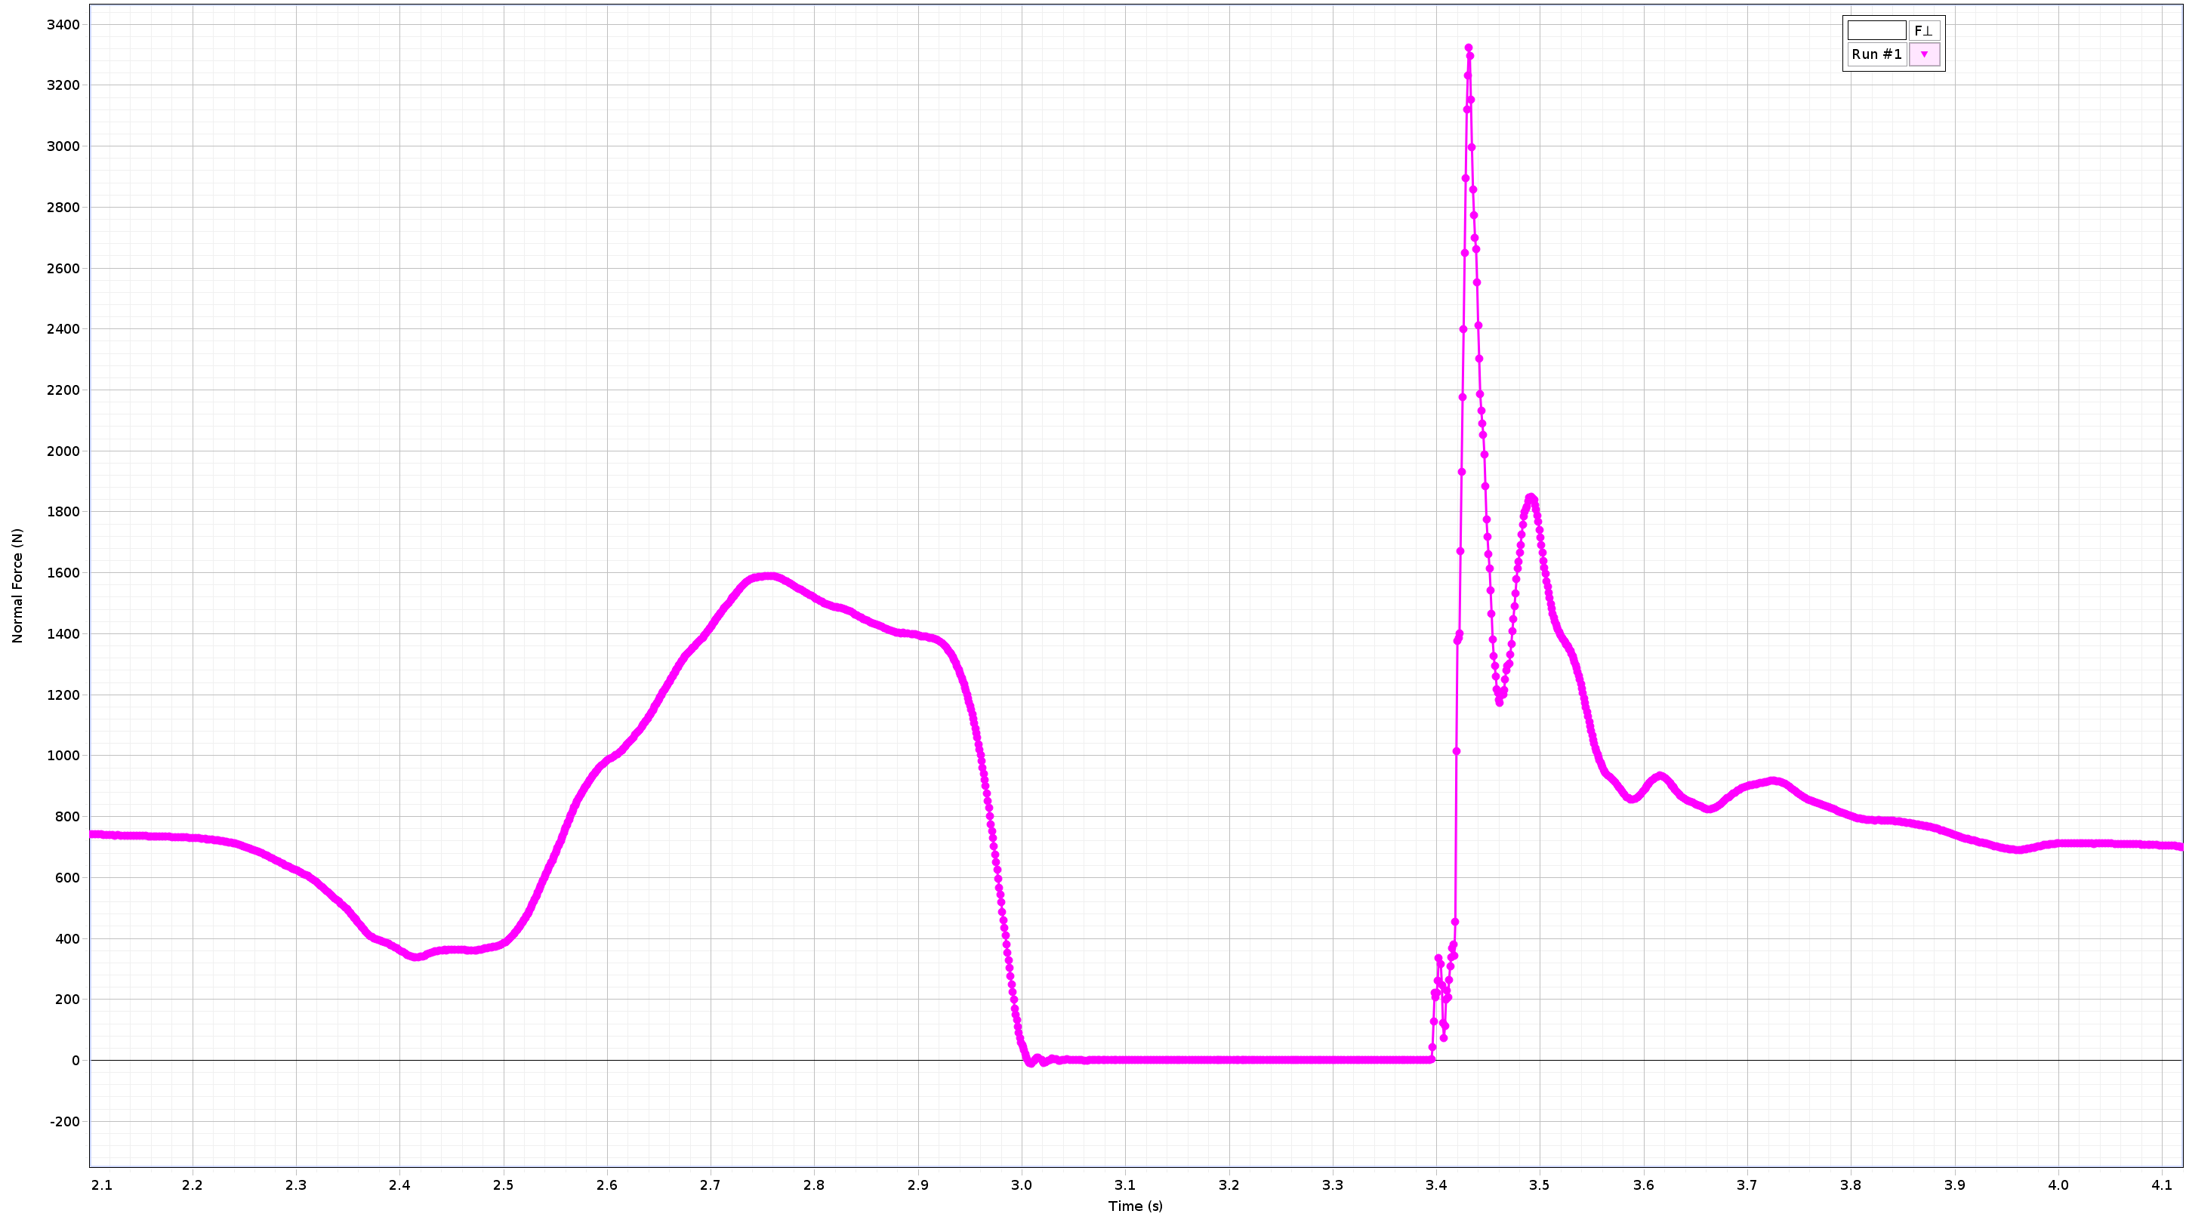
Key Changes from a “Standard” Textbook Curriculum
Additions
Omissions
Using a computer to numerically integrate motion^{[2][6]}
More complex F(t) graphs
Counting degrees of freedom and specific heat
Quantitatively incorporating chemical energy into energy conservation calculations
Statistical interpretation of entropy and connection to Gibbs free energy
Kinematic equations ← All done in simulation
Conservation of momentum
Angular kinematics
Heat engines
Calorimetry ← Our students have seen in chemistry

Slide 5
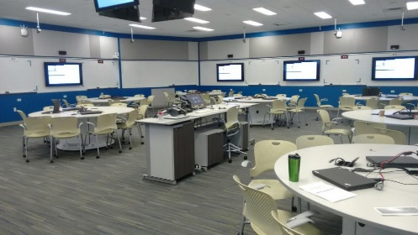
Our Room → Our Course Structure
Follow Michealsen et al’s Team-Based Learning^{[7]}
Immediate feedback is a guiding principle
[8]
Outside of class preparation
First day of unit
Individual Quiz
Team Quiz
Instructor Feedback
Six days of application activities

Slide 6
Student Preparation for Class is a Key Component
30% percent of course grade
Preparation assignment is typically
60 pages of reading
1.5 – 2 hours of simple problems
Learn how to learn by reading is a course goal
Custom edition of the textbook with notes to scaffold this skill
Perusall ^{[9]}
Level is important
Students are fully capable of learning definitions for symbols and algorithmic calculations
If you ask to learn problem solving → a lot of frustration and bad habits that you need to then help them un-learn
Consider the following statements about Newton's 2nd Law in general.
Select all of the statements that are true. Note, there may be more than one. Pay attention to synonyms: velocity and change in position are the same thing.
Accelerations are caused by the presence of a net force
A net force causes velocity.
If an object has a velocity, then we can conclude that there is a net force on the object
A net force causes velocity to change
A net force on an object will cause motion

Slide 7
In Class – Teams
All in-class activities are done in teams of five
Based upon the work of Kowitz and Knutson^{[10]} which gives the optimum team size of 5-7
Following Michaelsen et al, there are no team roles
Students are in the same teams throughout the semester
Teams are formed using ^{[11]}
Creates heterogeneous teams in: major, physics experience, gender identity, and race
Prevents soloing^{[12]}
Students evaluate each other empowering them to encourage accountability^{[13][14]}

Slide 8
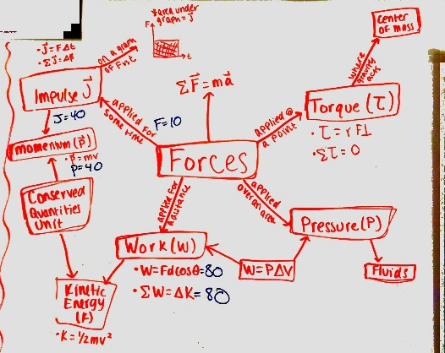
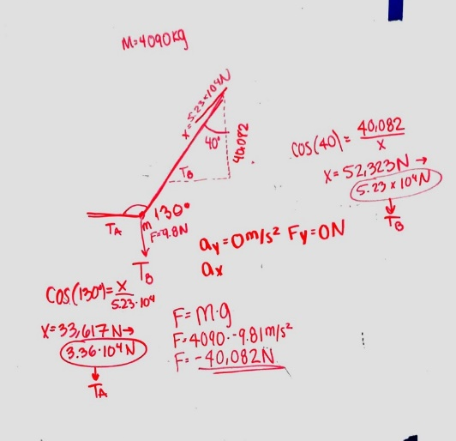
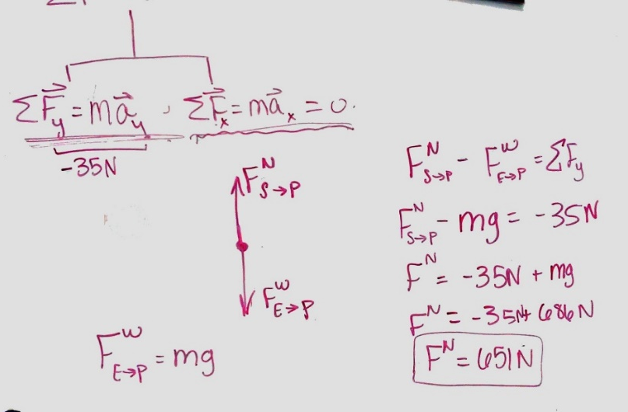
In-Class Activities – Whiteboards
Constructing concept maps
Problem solving at the whiteboards
Thinking in terms of words

Slide 9
Other In-Class Activities
Conceptual problems using voting cards
Fully integrated laboratory activities
Generating and interpreting graphs using sonic rangers
Simulating the motion of an object
Using a F(t) graph from a force plate to understand biomechanics^{[15]}
Monte Hall problem
Exploring free-expansion by using coin flips as a model

Slide 10
More Information and Future Directions
More details on this course including instructions for accessing our materials can be found on our website: http://physedgroup.umasscreate.net/p131/
Where we plan to go next:
Begin methodical assessment of what is and is not working in this system: up to this point we have been using informal surveys and assessment to develop
Which homework problems are most effective?
What impact on attitudes towards physics are we having?
Work with colleagues in other departments teaching the same students at UMass
Are we getting the topics right for our students?
Are we overlapping topics consciously?

Slide 11
Thank you

Slide 12
Backup slides

Slide 13
Collaborative vs. Team-Based Learning Systems^{[7]} | Recommendations of
 | Cooperative Learning (a la U. Minnesota) | Team-Based Learning
Area of Agreement
Groups: work in-class or out-of-class? | In-class | In-class
Areas where Recommendations Differ
Duration of groups | Half-term (or so) | Whole term
Size of groups | 4 or fewer | 5-7 students
Use assigned roles | Yes | No; counterproductive
Spend class time teaching and analyzing group process skills | Critically important | Nice, but not critical
Grade the group work | Maybe; maybe not | Critically important
Ensure prompt feedback on individual and group performance | Nice, but not critical | Critically important
Use peer assessment | Maybe | Critically important

Slide 14
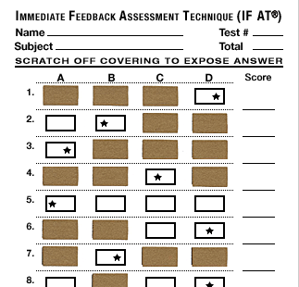
Exam Structure
Individual portion (Two hours) | 9-10 MC questions (4min each) Two long answer questions (10min each)
Ten minute break
Team portion* (45 min) | Exact same exam. Multiple choice portion done on IF-AT cards.
Total Time: Just under 3 hours
Guiding principles:
Both individual and group assessment
Immediate feedback
Mix of:
Conceptual questions (multiple choice)
Problem solving (long answer)
Universal design – minimize the need for accommodation by giving all students “double time” to complete the exam
All exams cumulative with the same format

Slide 15
Grade Breakdown
Multiplied by team multiplier: usually ~1 but can range 0.5 – 1.05
Individual Assignments Total | 65% | Team-Based Assignments Total | 35%
Five Preparation Assignments (One for each unit)
Preparation Homework Problems (~2hours) | 7.5%
Reading Comments (~60 pages) | 2.5%
Four Preparation Quizzes (None for unit 1): 50/50 Individual/Team
Individual Preparation Quizzes | 10% (2.5% each) | Team Preparation Quizzes | 10% (2.5% each)
Three Cumulative Exams: 75/25 Individual/Team
Individual Exams | 45% (15% each) | Team Exams | 15% (5% each)
Six Laboratory Exercises: Graded questions
 |  | Laboratory Reports | 10%
Notes:
Multiplier shows on click

Slide 16
References
Dawn C. Meredith, and Edward F. Redish. “De- and Re-Constructing Introductory Physics for the Life Sciences.” Accessed April 6, 2015. http://arxiv.org/abs/1304.1895.
E.F. Redish et al. “NEXUS/Physics: An Interdisciplinary Repurposing of Physics for Biologists.” Am. J. Phys. 82, no. 5 (2014): 368. doi:10.1119/1.4870386.
P. Sharp et. al. The Third Revolution: The Convergence of the Life Sciences, Physical Sciences, and Engineering. MIT, 2011. http://dc.mit.edu/sites/dc.mit.edu/files/MIT%20White%20Paper%20on%20Convergence.pdf.
Dreyfus, Benjamin W., Edward F. Redish, and Jessica Watkins. “Students’ Views of Macroscopic and Microscopic Energy in Physics and Biology.” ArXiv:1106.5801 [Physics], 2012, 179–82. doi:10.1063/1.3680024.
Frank Lambert. “Disorder—A Cracked Crutch for Supporting Entropy Discussions.” Journal of Chemical Education 79, no. 2 (February 2002): 187–92. doi:10.1021/ed079p187.
National Research Council. BIO2010: Transforming Undergraduate Education for Future Research Biologists, 2002. https://www.nap.edu/catalog/10497/bio2010-transforming-undergraduate-education-for-future-research-biologists.
Larry K. Michaelsen, Arletta Bauman Knight, and L. Dee Fink. Team Based Learning: A Transformative Use of Small Groups in College Teaching. Sterling, VA: Stylus, 2004.
Slepkov, Aaron D. “Integrated Testlets and the Immediate Feedback Assessment Technique.” American Journal of Physics 81, no. 10 (September 20, 2013): 782–91. doi:10.1119/1.4820241.
Stoltzfus, Matthew W. “Active Learning in the Flipped Classroom: Lessons Learned and Best Practices To Increase Student Engagement.” In The Flipped Classroom Volume 1: Background and Challenges, 1223:105–22. ACS Symposium Series 1223. American Chemical Society, 2016. doi:10.1021/bk-2016-1223.ch008.
Kowitz A.C, Knutson T.J., Decision making in small groups: The search for alternatives. Allyn and Bacon. Boston. 1980.
Layton, R. A., Loughry, M. L., Ohland, M. W., & Ricco, G. D. (2010). Design and validation of a web-based system for assigning members to teams using instructor-specified criteria. Advances in Engineering Education, 2 (1), 1-28.
White, Judith B. “Fail or Flourish? Cognitive Appraisal Moderates the Effect of Solo Status on Performance.” Personality and Social Psychology Bulletin 34, no. 9 (September 1, 2008): 1171–84. doi:10.1177/0146167208318404.
Ohland, M. W., Loughry, M. L., Woehr, D. J., Finelli, C. J., Bullard, L. G., Felder, R. M., Layton, R. A., Pomeranz, H. R., & Schmucker, D. G. (2012). The comprehensive assessment of team member effectiveness: Development of a behaviorally anchored rating scale for self and peer evaluation. Academy of Management Learning & Education, 11 (4), 609-630.
Loughry, M. L., Ohland, M. W., & Moore, D. D. (2007). Development of a theory-based assessment of team member effectiveness. Educational and Psychological Measurement, 67, 505-524.
Dr. Jill L. McNitt-Gray. “Exsc 408l: Biomechanics Lab.” Course Webpage. Biomechanics - EXSC 408L. Accessed March 6, 2016. http://www.usc.edu/dept/LAS/kinesiology/exsc408l/.

